Slide 1
Rubik’s Cube Solver
Applied Computer Vision
Vitalii Zakharov

Slide 2

Program abilities

Slide 3
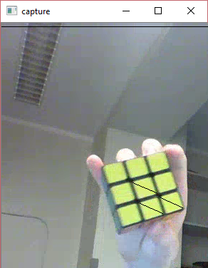
Recognition process

Slide 4
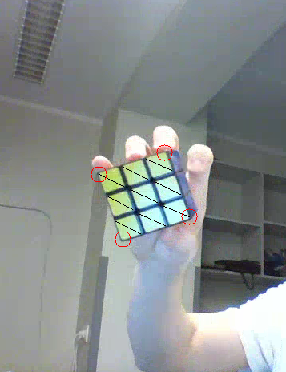

Face extraction

Slide 5
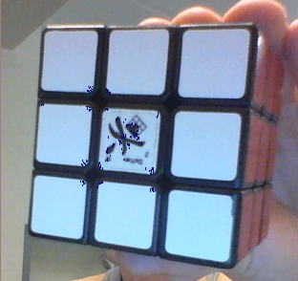
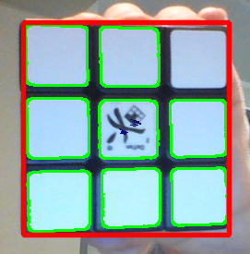
PTAM based extraction

Slide 6
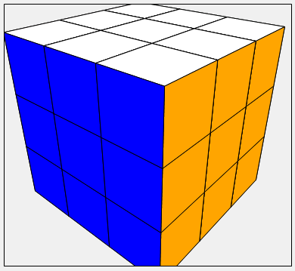
Extracted color mapping

Slide 7
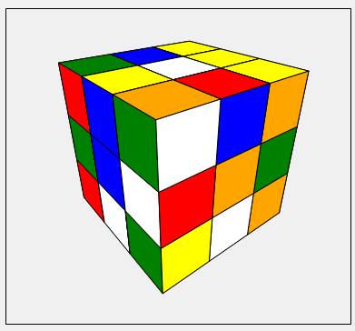
Shuffled Rubik’s cube model

Slide 8
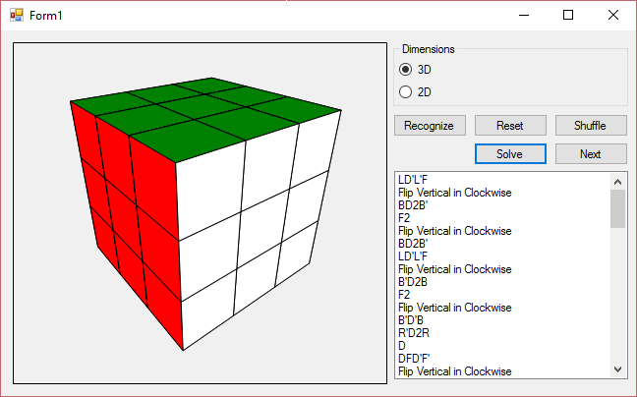
Final program window

Slide 9
Literature
Rubik's Cube Localization, Face Detection, and Interactive Solving. http://cs231n.stanford.edu/reports/jaykevin_final.pdf
Rubik’s Cube Solver. http://www1.idc.ac.il/toky/ImageProcAndroid-14/RubiksCube/Report.pdf
3D Pose Estimation. http://www.aforgenet.com/articles/posit/
Introduction to SURF (Speeded-Up Robust Features). http://docs.opencv.org/3.0-beta/doc/py_tutorials/py_feature2d/py_surf_intro/py_surf_intro.html
Pose Estimation. http://docs.opencv.org/trunk/d7/d53/tutorial_py_pose.html#gsc.tab=0
Bootstrapping planar AR and tracking without markers. http://www.morethantechnical.com/2015/03/16/bootstrapping-planar-ar-tracking-without-markers-wcode
Kalman Filter. http://greg.czerniak.info/guides/kalman1

Slide 10
Thank you for attention!

